Slide 1
Intelligence Business Solutions Vietnam
EVALUATION POLICY
(For Fresh Graduate)
Published on: 01st July 2015
Valid from: 01st July 2015
Approved by: Yoshihito Satoyoshi – General Manager

Slide 2
I – GENERAL REGULATIONS
1. Become to IBSVN’s staff, you have 2 times for evaluation every year: End of June and end of December
2. There are 2 types of evaluation:
2.1. Give you the minimum percentage that IBSVN to ensure to increase within 5 years working
2.2. Upgrade to new level if excellent performance
II – PRINCIPLE FOR MINIMUM INCREASE WITHIN 5 YEARS
 | 1Y | 2Y | 3Y | 4Y | 5Y
Jan |  | 5% up | 15% up | 10% up | 10% up
Feb
Mar
Apr
May
Jun
Jul |  | 10% up | 15% up | 10% up | 10% up
Aug
Sep
Oct
Nov
Dec
MEMO
- Fixed percentage for increase
1st evaluation
- If you start to work from Jan to Jun, 1st evaluation is at the end of Dec, and the valid is from Jan of 2nd year
START
- If you start to work from Jul to Dec, 1st evaluation is at the end of Jun next year, and the valid is from Jul of 2nd year
- Total 8 times is for increasing salary within 5 years working in IBSVN
1st evaluation
This is a minimum guarantee that IBSVN offer to you for 5 years working
START

Slide 3
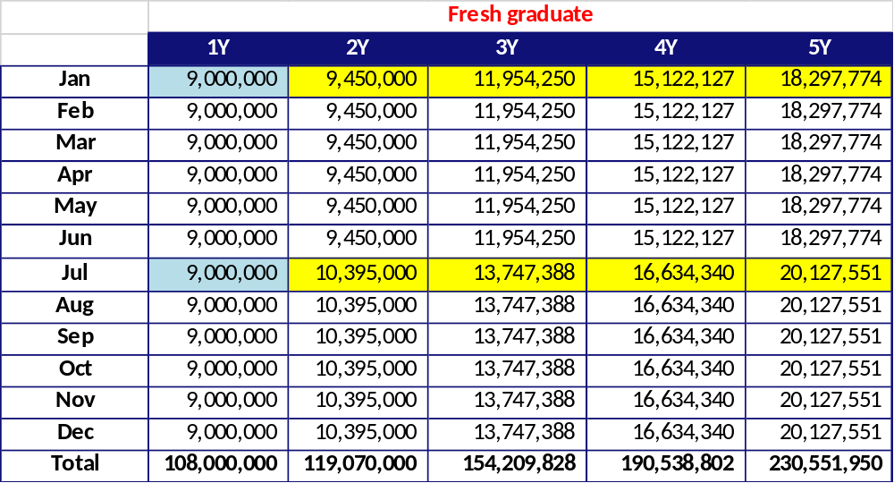
III – SAMPLE SPREADSHEET
Start salary Example
5%
15%
10%
10%
10%
15%
15%
10%
10%

